Slide 1
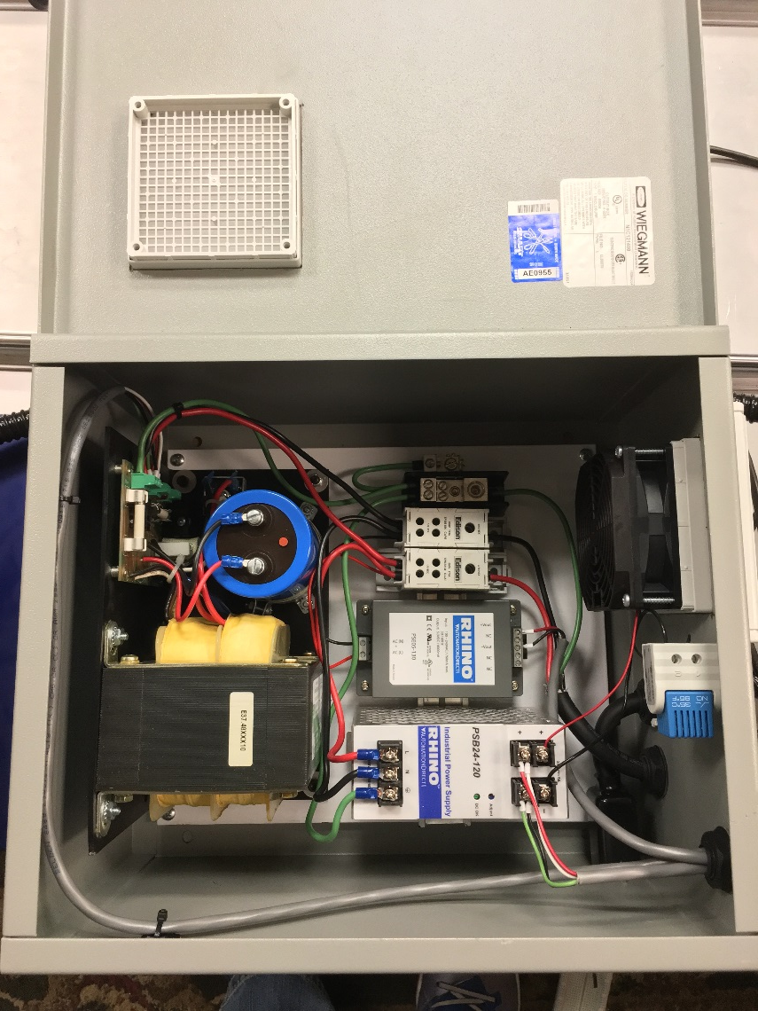
Systems - Power Distribution Module
120 VAC input
Power Distribution Module:
48 V 10 A power supply for stepper motors
24 V 5 A power supply for light bars, stack light and fans
12 V 6 A supply for Arduino
Thermostatically controlled fan

